Slide 1
The Evolution of Kikuyu Gender Roles
From the 'Nyumba' to Modern Equity
Wimwega. My name is Evans Mwaura Mburu, a Computer Science student at Dedan Kimathi University of Technology. Born in Rongai and raised in the bustling town of Ruiru, I have always been fascinated by how systems work—whether they are computer systems or social systems.
Today, I am presenting on a topic close to my heart and my heritage: 'The Evolution of the Nyumba and Gender Roles in Kikuyu Society.'
We often talk about gender awareness as a modern concept, but our ancestors had a very specific, structured way of viewing gender. Today, I will take you on a journey from the traditional homesteads of Kiambu to the modern digital world I inhabit today, analyzing how the roles of men and women have shifted and why gender equity is crucial for Africa’s future.

Slide 2
The Traditional Homestead: A Structured Society
To understand where we are, we must understand where we came from. In the traditional Kikuyu setting, the homestead was not just a collection of houses; it was an institution, meticulously designed to foster order and community.
The Nyumba: Woman's Domain
The Thingira: Man's Domain
The 'Nyumba'—the woman's house—was the vibrant heartbeat of the family. It was the central hub for daily life, where meals were prepared, children were nurtured, and the foundational moral values of the next generation were instilled. This space was a sanctuary of domesticity and the primary center for child-rearing, embodying the essence of family life and continuity.
Opposite the Nyumba was the 'Thingira'—the man’s hut. Far more than just a sleeping area, the Thingira served as a vital educational and political center. Here, young boys received mentorship from their fathers and elders, learning the rich history of their clan, the intricate responsibilities of manhood, and the principles of governance. It was a place of learning, discussion, and decision-making for the male members of the community.
Growing up in Ruiru, in a modern urban setting, this physical separation no longer exists in the same way. However, understanding this distinction is key. It wasn't necessarily about oppression; it was about order. The roles were distinct, yet the survival of the homestead depended on the harmony between the Nyumba and the Thingira, each contributing uniquely to the collective well-being.

Slide 3
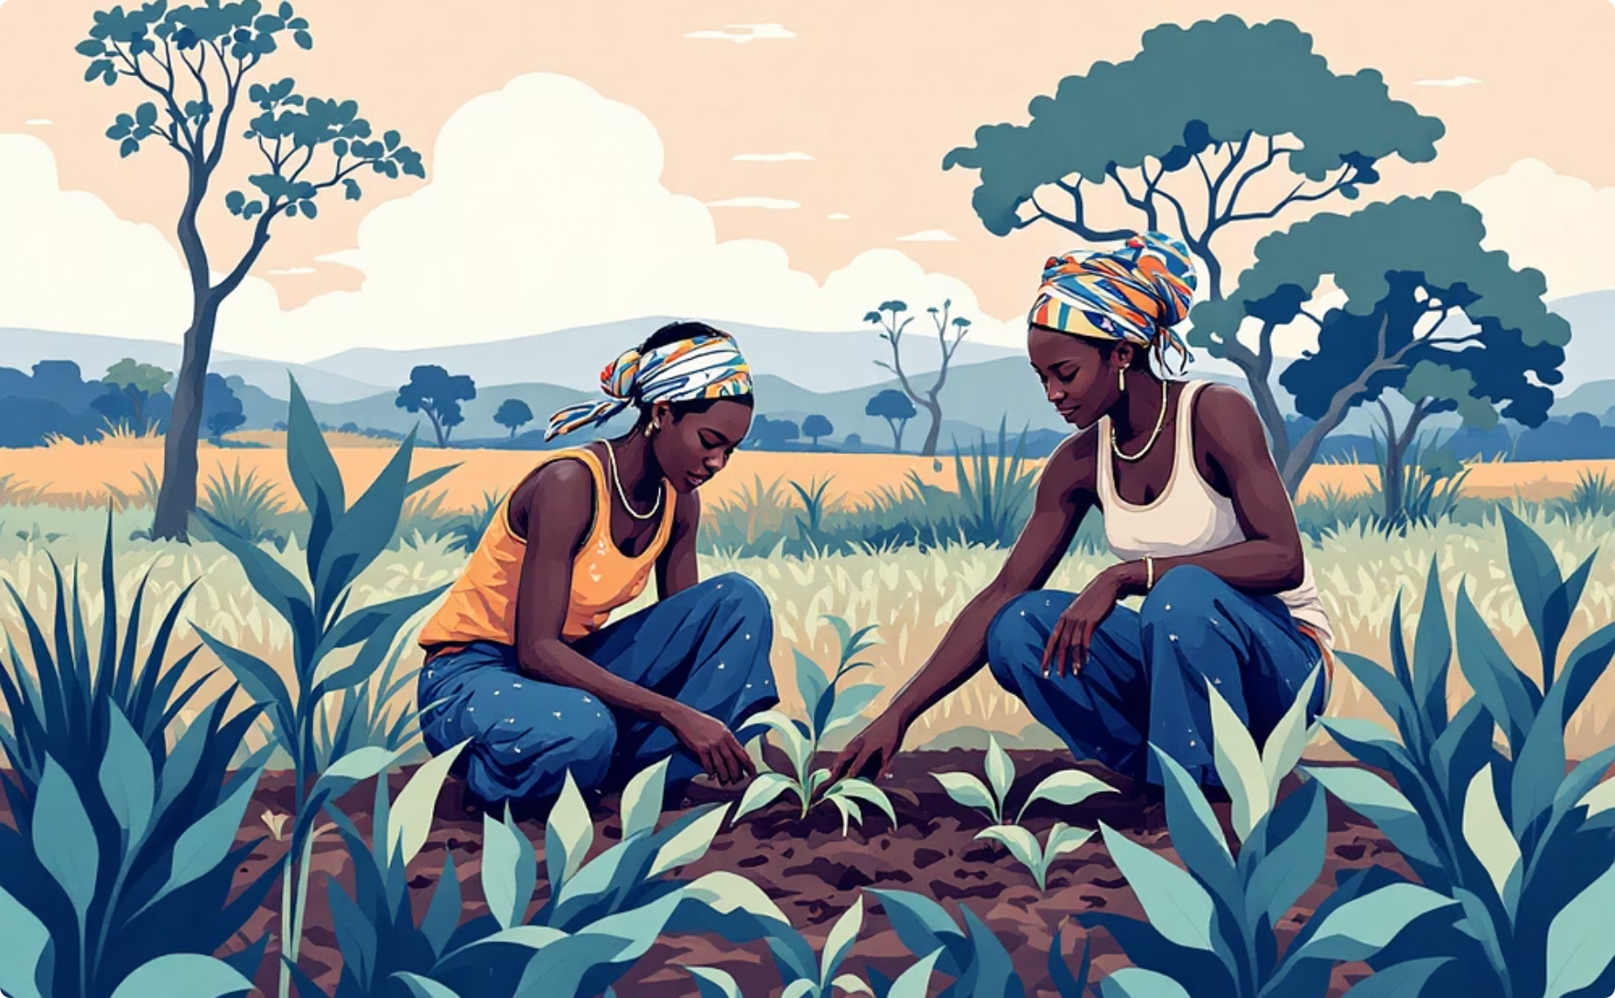
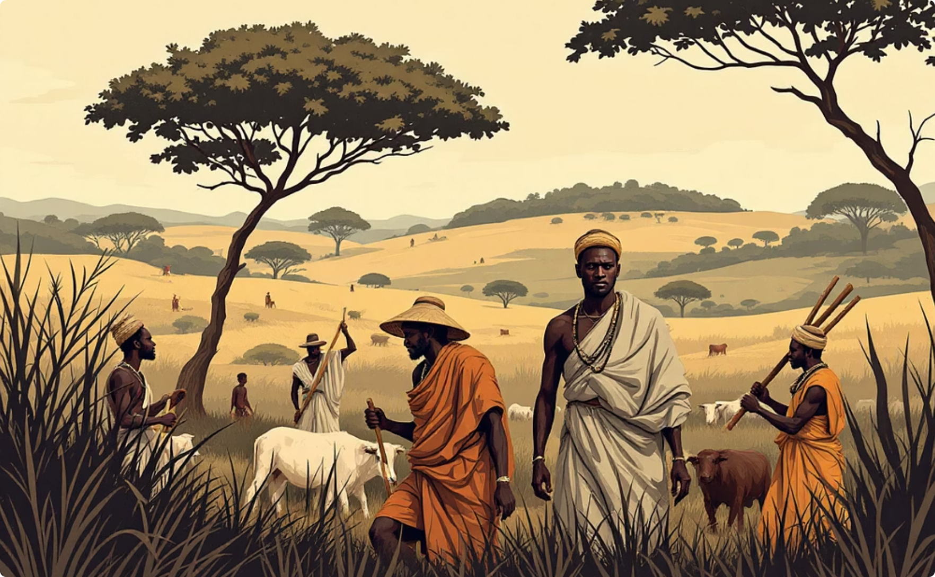
Division of Labor: Pre-Colonial Mutual Dependence
The pre-colonial Kikuyu society operated on a sophisticated system of mutual dependence, where distinct gender roles ensured the survival and prosperity of the community. This division of labor, though patriarchal, recognized the indispensable contributions of both men and women.
Women's Contributions
Men's Contributions
Agriculture: The Kikuyu women were the agriculturalists, the backbone of the economy. They managed planting, cultivating, and harvesting, ensuring food security for their families and communities.
Defense & Protection: Men were primarily the protectors of the community, safeguarding against external threats and ensuring the safety of their families and livestock.
Water & Firewood: They were responsible for fetching water and gathering firewood, tasks that required immense physical endurance and played a crucial role in daily household sustenance.
Land Clearing: They undertook the arduous task of clearing heavy brush to open new land for cultivation, expanding agricultural capacity.
Home Management: Within the Nyumba, women held significant authority, managing household affairs, raising children, and instilling moral values.
Livestock Management: Herding livestock, which served as the family's primary form of wealth and security, was a key male responsibility.
Governance: Through the Council of Elders, men handled matters of law, order, and community governance, making crucial decisions for the clan.
It was a system of mutual dependence. A man could not eat without the woman’s diligent work in the shamba, and the woman could not farm safely without the man’s protection. While it was a patriarchal society, the woman held immense power within the Nyumba. Her voice was decisive in matters of the home, highlighting a balance of influence despite the clear division of roles.

Slide 4



Catalysts for Change: Shifting Dynamics
The traditional structures of Kikuyu society, while robust, were not immutable. Several powerful forces, initially introduced by colonialism, profoundly accelerated the transformation of gender roles, leading to the blurring of the distinct domains of the Nyumba and Thingira.
Education: The Great Equalizer
Urbanization: New Living Spaces
Economy: From Subsistence to Formal
The introduction of formal education, particularly when schools opened their doors to both boys and girls, was a monumental shift. The 'Thingira' ceased to be the sole repository of knowledge. Girls gained access to learning previously reserved for men or entirely new to the society, empowering them with new perspectives and opportunities.
The migration from rural homesteads to urban centers like Ruiru fundamentally altered the physical and social landscape. In apartments or bungalows, the traditional 'compound' dynamic disappeared. There was no separate 'Thingira'; kitchens and living spaces became shared, forcing a re-evaluation of domestic roles and responsibilities.
The shift from subsistence farming to a monetary, formal employment economy was another critical catalyst. In the past, a man's provision was measured in livestock; today, it is about financial income. In modern Kenya, women are increasingly capable—and often primary—income earners in the formal sector, shattering the old division of labor and economic dependence.
These intertwined factors created an environment where traditional gender expectations began to erode, paving the way for new social dynamics and a redefinition of roles within the Kikuyu community and beyond.

Slide 5




Modern Gender Dynamics: Shared Responsibilities
The strict lines that once defined the Nyumba and the Thingira have significantly blurred, giving rise to a more fluid and integrated approach to gender roles. Today, we observe a profound shift towards shared responsibilities and increased female leadership across various sectors.
Shared Parenting & Provision
Women in Leadership
Balancing Tradition & Progress
It is no longer taboo for a man to cook, care for a baby, or participate actively in household chores. Similarly, it is common for women to be primary breadwinners, contributing significantly to family finances. This evolution fosters a more equitable distribution of domestic and financial responsibilities.
Women are increasingly taking on prominent roles in technology, politics, and corporate environments. In fields like Computer Science, female colleagues are coding complex algorithms and leading projects, demonstrating that intellect and capability are not gender-specific.
This transition, however, is not without its challenges. Some individuals still cling to outdated definitions of masculinity, which can lead to gender-based violence or toxic dynamics. The ongoing task is to navigate this balance, preserving valuable cultural elements while embracing necessary societal progress.
True Gender Awareness means acknowledging that while our biology differs, our potential to contribute to society is equal. We must redefine respect—not as knowing your 'place,' but as valuing the other person's unique contributions and inherent worth. This redefinition is crucial for fostering a harmonious and progressive society.

Slide 6

The Imperative of Gender Equity for Africa's Future
As we navigate the complexities of modern development, gender equity is not merely a social ideal but an economic and societal necessity for Africa's sustained progress. The continent's future hinges on the full participation and empowerment of all its citizens, regardless of gender.
1
2
3
Unleashing Economic Potential
Driving Innovation & Development
Strengthening Social Fabric
When women are empowered to participate fully in the economy, GDPs rise. Investing in women's education and entrepreneurship leads to higher household incomes, reduced poverty, and stronger national economies. Their contributions move beyond traditional roles into innovative sectors.
Gender equity leads to healthier, better-educated families and communities. Empowered women are more likely to invest in their children's education and health, breaking cycles of poverty and fostering a more stable and prosperous society for future generations.
Diverse perspectives, including those of women, are critical for innovation. In fields like technology, science, and governance, female leaders and contributors bring unique insights that lead to more comprehensive solutions and accelerate national development goals.
Africa cannot afford to leave half of its population behind. The collective brilliance, resilience, and innovative spirit of both men and women are essential to tackle the continent's challenges and unlock its vast potential. Gender equity is the cornerstone of a thriving, inclusive, and sustainable African future.

Slide 7
Bridging the Gap: Challenges and Opportunities
While significant progress has been made in advancing gender equity, the journey is far from over. Bridging the remaining gaps requires addressing persistent challenges and seizing new opportunities to foster a truly inclusive society.
Key Challenges
Emerging Opportunities
Cultural Resistance: Deep-seated patriarchal norms and traditional expectations can hinder the acceptance of evolving gender roles, leading to resistance and friction within communities.
Policy & Legislation: Progressive policies and legal frameworks promoting gender equality in education, employment, and political representation are creating enabling environments.
Gender-Based Violence: Unfortunately, the transition period can sometimes exacerbate issues like gender-based violence, as some cling to outdated power dynamics.
Technological Advancement: Digital literacy and access to technology can empower women with new skills, entrepreneurial avenues, and platforms for advocacy and voice.
Economic Disparities: Despite progress, women often face greater barriers to economic empowerment, including unequal pay, limited access to resources, and underrepresentation in leadership positions.
Youth Engagement: Younger generations are increasingly advocating for gender equity, challenging traditional norms, and fostering more inclusive attitudes from an early age.
Community-Led Initiatives: Grassroots movements and community programs are effectively addressing local challenges, promoting dialogue, and implementing solutions tailored to specific cultural contexts.
Access to Education: While education is a great equalizer, disparities in access and quality still exist, particularly in rural areas, limiting opportunities for girls and women.

Slide 8
The Role of Education in Redefining Gender
Education has been, and continues to be, the most potent catalyst for transforming gender roles and fostering a more equitable society. It transcends traditional boundaries, offering new pathways for individuals and communities.
01
02
Breaking Down Barriers
Empowering Economic Independence
Formal education challenged the notion that learning was exclusive to the 'Thingira'. By opening schools to girls, it dismantled the intellectual segregation, allowing women to access knowledge previously denied or unavailable to them.
Education equips women with skills and qualifications necessary for formal employment, enabling them to become financially independent. This economic autonomy significantly alters traditional power dynamics within households and communities.
03
04
Fostering Critical Thinking
Shaping Future Generations
Beyond vocational skills, education cultivates critical thinking, enabling individuals to question traditional norms, challenge inequalities, and advocate for their rights and the rights of others. It promotes a deeper understanding of societal structures.
Educated parents, especially mothers, are more likely to prioritize their children's education, creating a virtuous cycle. They instill values of equality and opportunity, shaping future generations that are more open-minded and gender-aware.
My own journey as a Computer Science student at Dedan Kimathi University of Technology exemplifies this transformative power. Education has provided me with the tools to analyze both computer and social systems, reinforcing the belief that knowledge is the ultimate liberator and equalizer.

Slide 9




Embracing Equity: The Spirit of Ubuntu
In conclusion, my journey from Ruiru to the world of technology has taught me one profound lesson: Adaptability is survival. Just as the Kikuyu people adapted from the forests to the farms, and from the farms to the cities, we must now adapt our social structures to embrace true equity.
Preserving Core Values
Intelligence Knows No Gender
We can retain the invaluable values of our culture—respect, family unity, and resilience—without clinging to the restrictions that historically limited women's potential and participation.
As I look toward a future in Cybersecurity and Development, I know that Kenya cannot truly develop if we leave half of our population behind in the metaphorical 'Nyumba.' The brain does not have a gender; brilliance is universal.
Ubuntu: We Rise Together
Collective Advancement
This is the spirit of Ubuntu—"I am because we are." It signifies that our individual well-being is deeply intertwined with the well-being of our community. We rise together, or we do not rise at all.
We need the brilliance of our mothers, sisters, and daughters in the boardroom, in the lab, and in government. Their insights and contributions are essential for holistic national growth and innovation.
Embracing equity means redefining respect—not as knowing your 'place,' but as valuing every person's unique contribution. It is about fostering an environment where every individual, regardless of gender, has the opportunity to thrive and contribute to a stronger, more prosperous Africa. Thank you. Ni thewa.

Slide 10
The Path Forward: A Vision for Inclusive Growth
The journey from traditional gender roles to modern equity is an ongoing process, demanding continuous effort, dialogue, and adaptation. Our vision for Africa's future must be one of inclusive growth, where every voice is heard and every talent is harnessed.
Acknowledge the Past
1
Understand and respect the historical context of traditional roles, recognizing their original functions while identifying limitations in a modern world.
2
Educate & Empower
Continue to invest in education for all genders, fostering critical thinking and providing skills necessary for economic independence and societal contribution.
Challenge Norms
3
Actively question and dismantle harmful gender stereotypes and patriarchal structures that impede progress and perpetuate inequality.
4
Promote Shared Responsibility
Encourage equitable distribution of domestic, caregiving, and financial responsibilities within households and communities.
Champion Leadership
5
Support and elevate women into leadership roles across all sectors, from local governance to national policy-making and corporate boards.
6
Innovate for Inclusion
Leverage technology and innovative solutions to create new opportunities and platforms that bridge gender gaps and foster inclusive development.
This path forward is not just about women's rights; it is about human rights and the collective prosperity of our continent. By consciously working towards gender equity, we build stronger families, more vibrant communities, and a more resilient and innovative Africa for all.

